Slide 1
THE TITANIC: SURVIVAL outcomes and its variance
By Ben Bridge

Slide 2
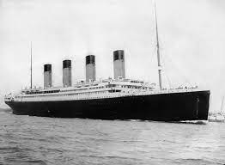

Titanic background and dataset BACKGROUND
Census data on Passengers onboard the Titanic, which sank in 1912
891 Passenger sample
549 did not survive, 342 did
61% of Passengers died
Looks at cohorts such as Age, Fare Price, Number of Spouses etc.

Slide 3
THE VARIABLES
Independent Variables:
Passenger Class – 1st, 2nd, 3rd
Sex – Male or Female
Age – not grouped – continuous variable
Number of Siblings, Spouses, and Children, Parents onboard
Fare Price – continuous variable
Port Embarked from – Cherbourg, Queenstown, and Southampton
Not included:
Cabin position – over 500 data points missing

Slide 4
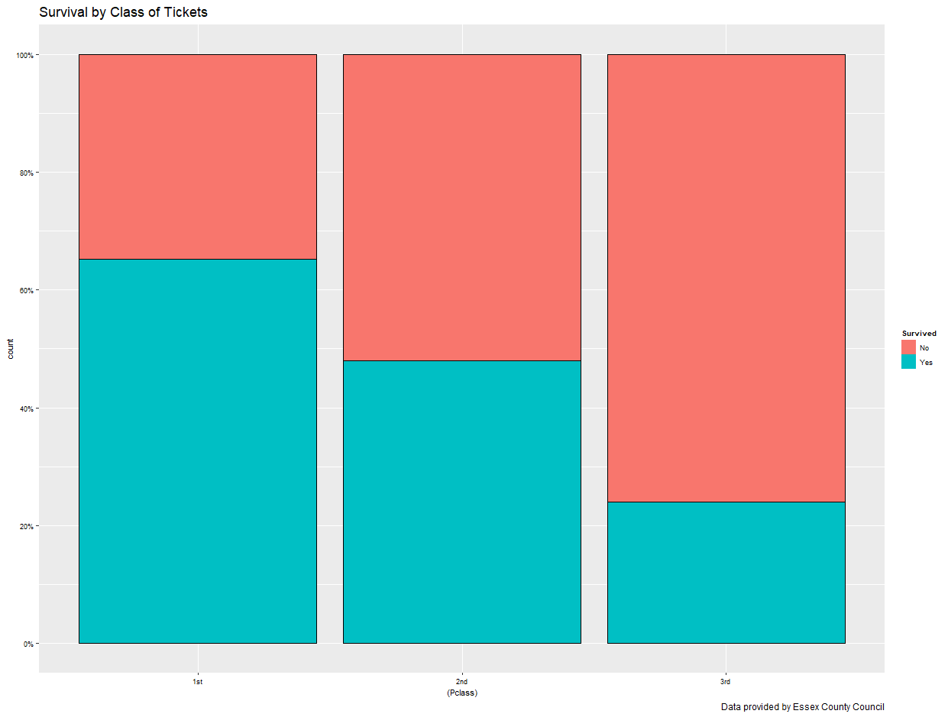
DESCRIPTIVE STATISTICS

Slide 5
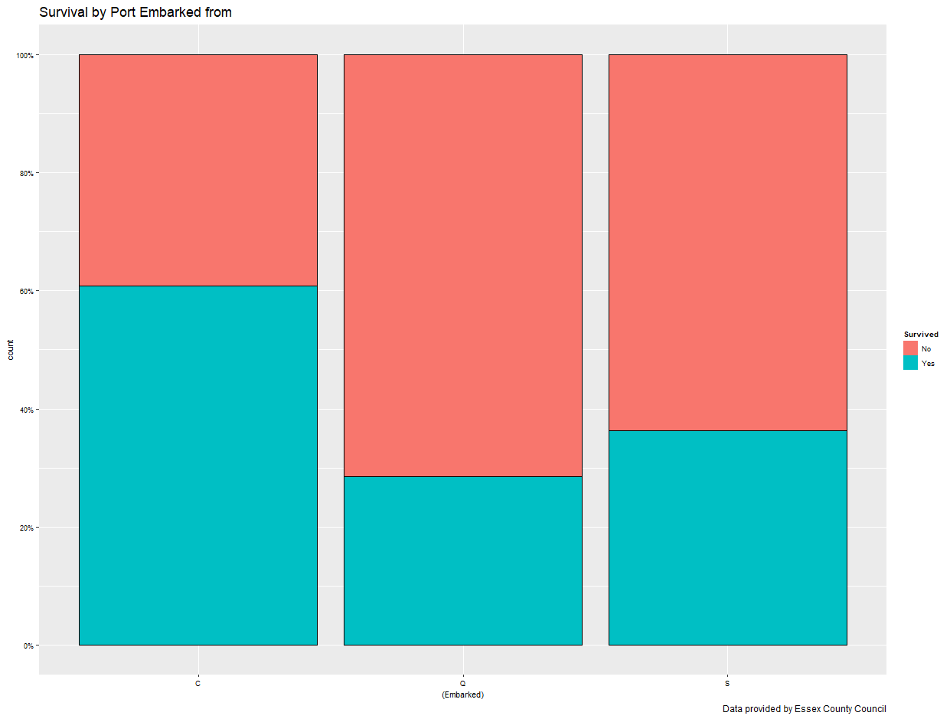
DESCRIPTIVE STATISTICS

Slide 6
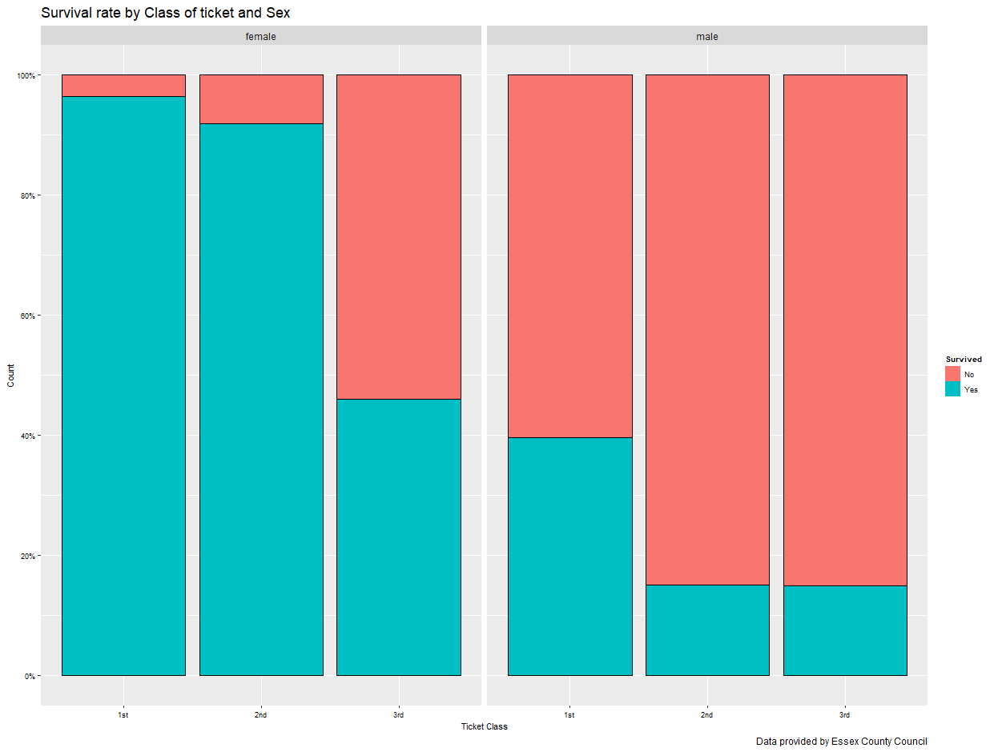
DESCRIPTIVE STATISTICS

Slide 7
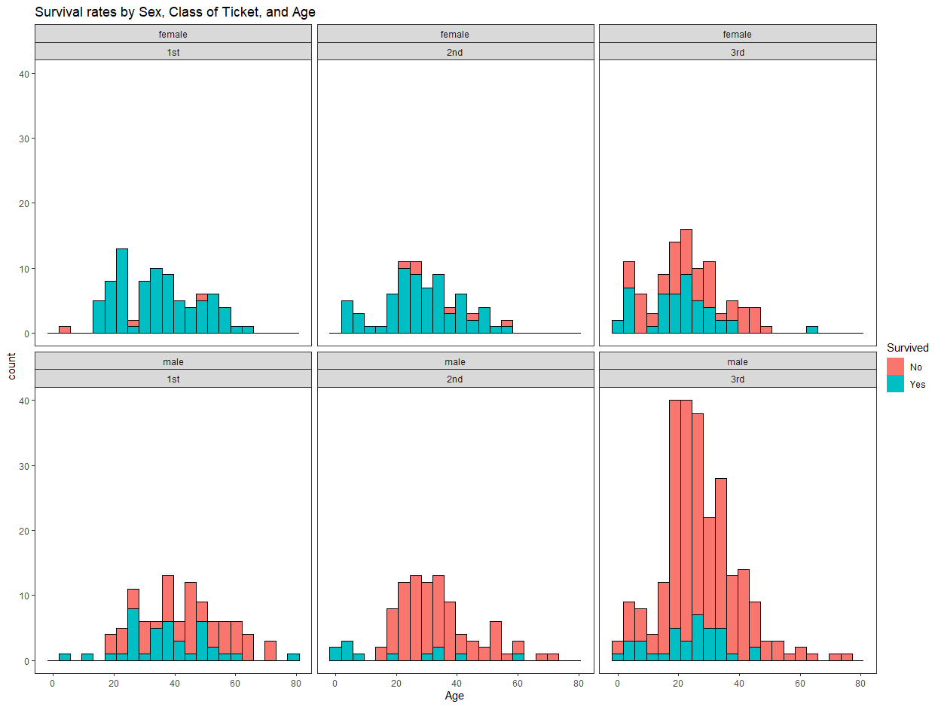
DESCRIPTIVE STATISTICS

Slide 8
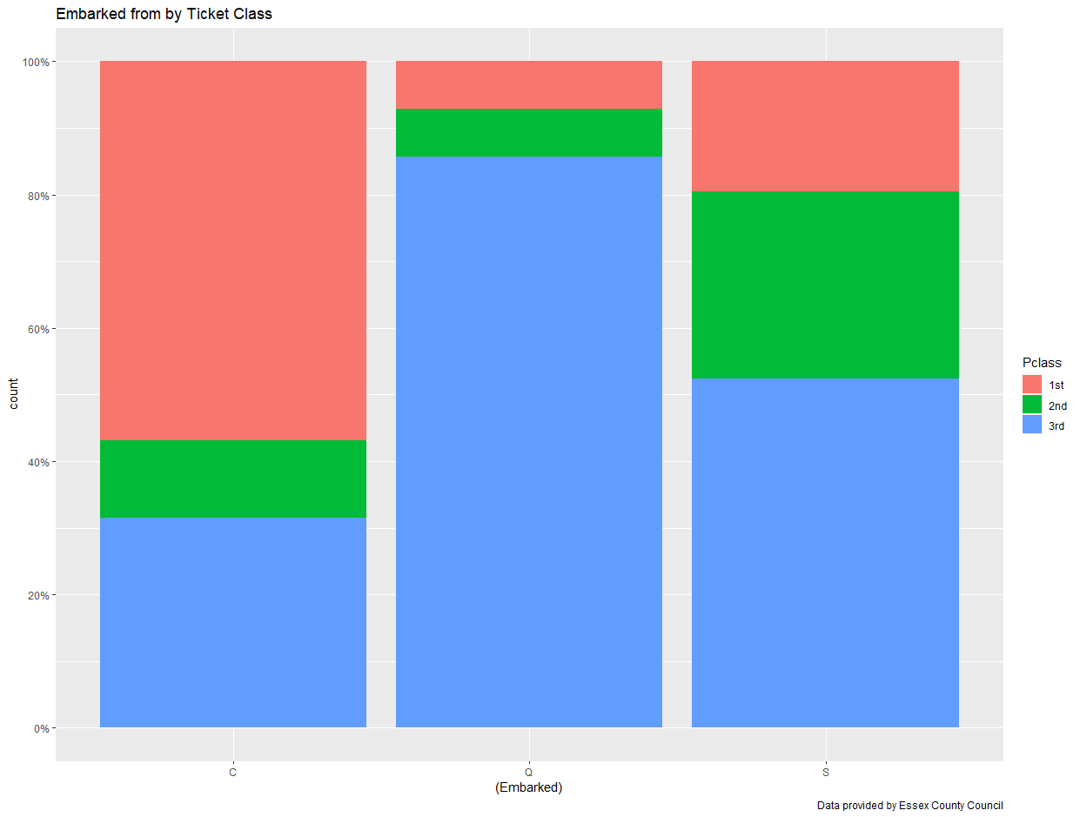
POTENTIAL CONFOUNDING VARIABLES

Slide 9
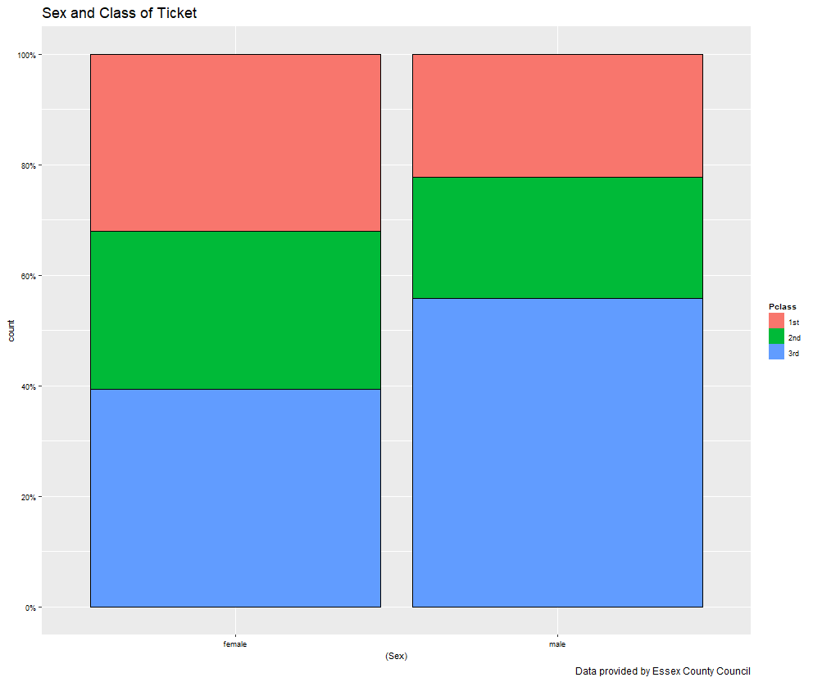
POTENTIAL CONFOUNDING VARIABLES

Slide 10
ROUNDUP OF DESCRIPTIVES
From some of what I have explored and displayed here:
There seems to be some strong links between people’s Sex and Survival rate, not so much Age surprisingly
Overall, there seems to be an undercurrent of class/ social status informing the analysis of the Titanic catastrophe
And some other interesting explored links that were not in visual form here …

Slide 11
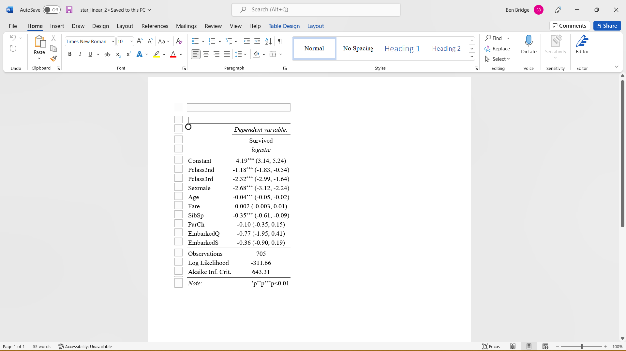
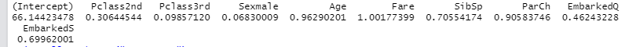
LOGISTIC REGRESSION ANALYSES
Model 1:

Slide 12
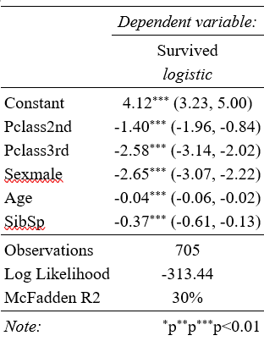
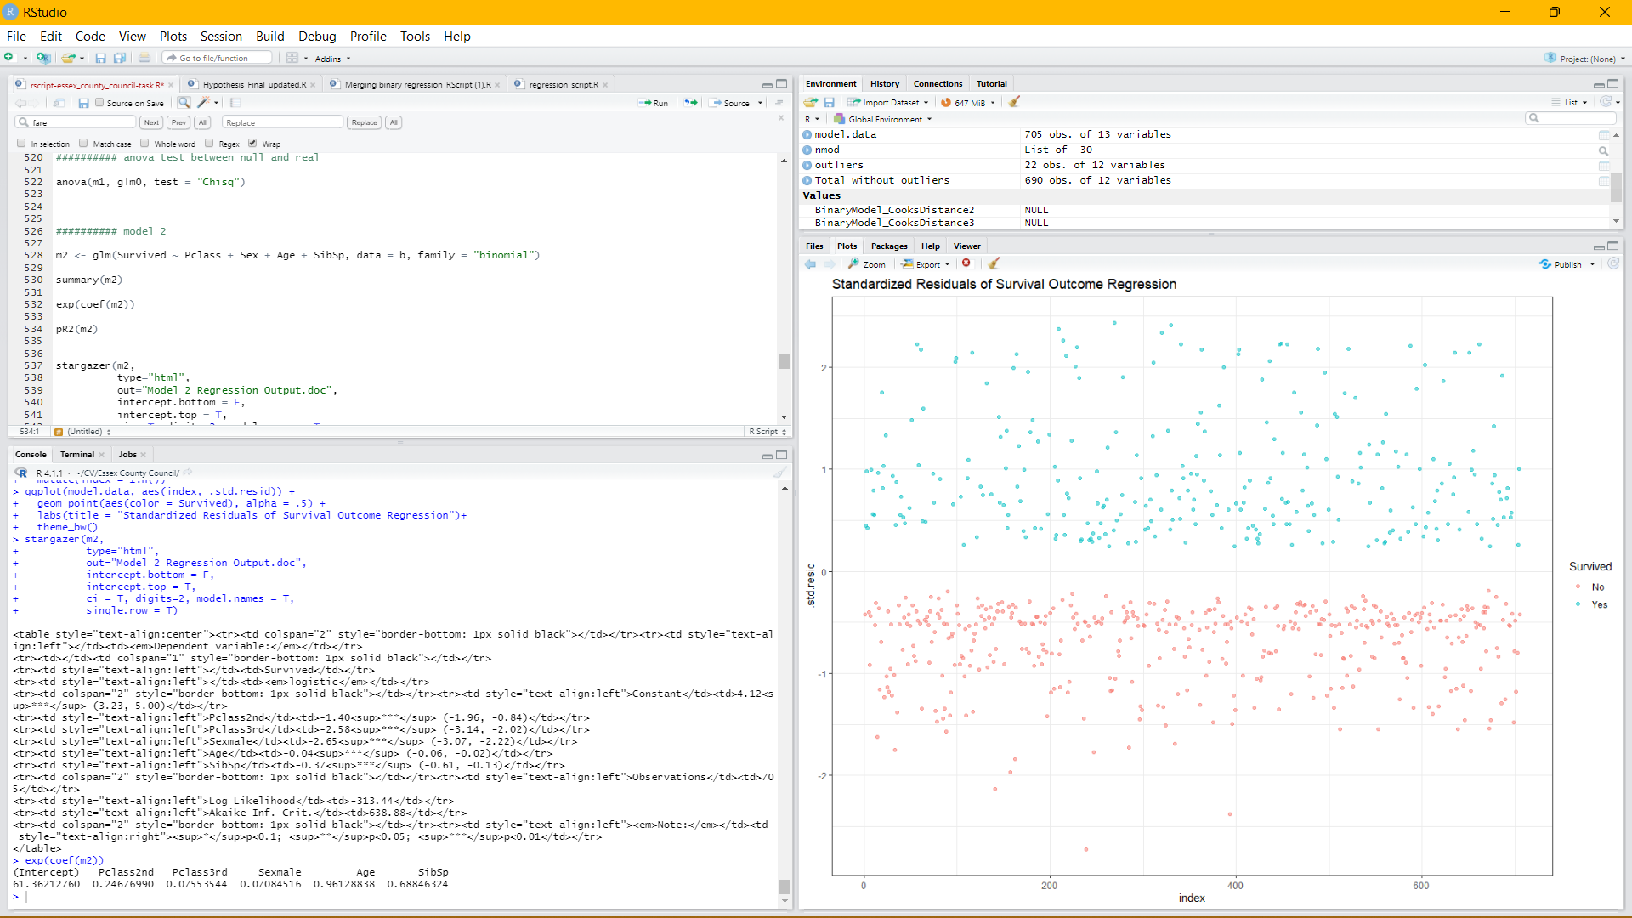
LOGISTIC REGRESSION ANALYSES
Model 2:

Slide 13
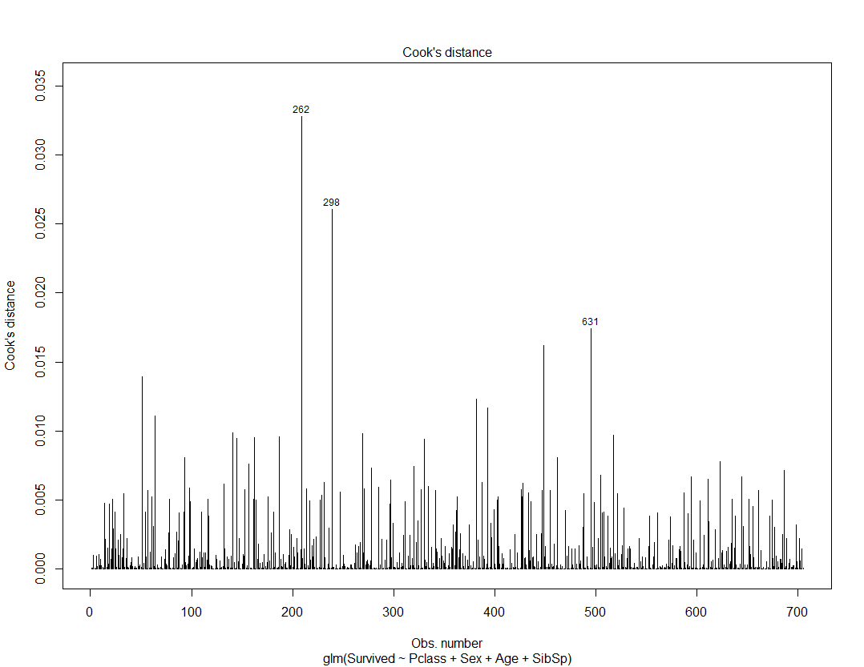
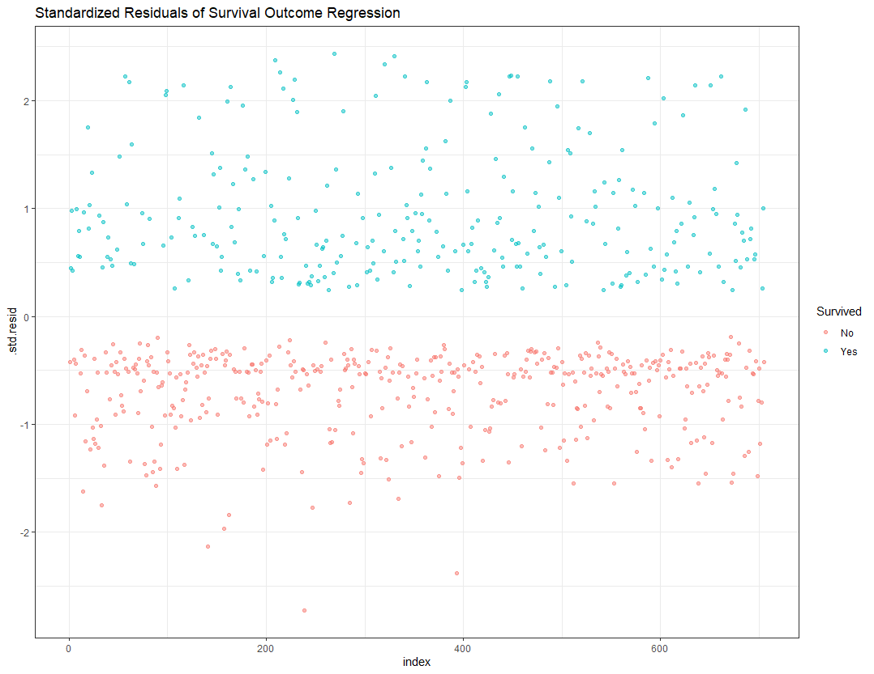
LOGISTIC REGRESSION DIAGNOSTICS
Notes:
Cook’s Distance is showing that some influential outliers could be skewing the results of our Regression
262 – Male, Embarked from Southampton, 3yr old, 3rd class ticket, survived – does not seem to be an inputting error
298 – Female, 1st class, didn’t survive

Slide 14
LIMITATIONS
Quite a few missing values for the variable Age, so we lose a bit of nuance in our model, but we would even if not included – given its statistical significance
Over 500 missing values for Cabin location of Passengers (miss out on looking at the differences between luxury and non-luxury cabin location)

